Slide 1
BMO Strategic Equity Yield Fund
Income Generation With Structured Outcomes
Broker/Advisor Use Only. Not for Public Distribution.

Slide 2
Our Clients’ Focus for 2023 and Beyond
Investors continue to search for stable income with equity exposure
Recent volatility in the market has renewed concern for downside protection on investments
Recent correction of tech, banks and other sectors has increased interest in geographic and sector diversification
Solution?
Structured Notes

Slide 3
Structured Notes – The Engine Behind Convergence Investing
Structured notes are hybrid securities with characteristics of both fixed income and equity instruments
They are designed to offer market-linked growth potential
Structured Notes have rapidly grown as an asset class
In Canada, $50-60bn worth of notes outstanding at any given time. All major banks issue notes
In the U.S., it is expected that there will be US$100B in new issuance in 2023
Very popular investment instrument in European and Asian markets
Bonds
Equity
Structured Notes
The Future Of Investment Portfolios
Convergence Investing
A new generation of mutual funds, providing access to sophisticated strategies previously unavailable
The Next Era of Mutual Funds
Aims to level the playing field for Canadian investors
Expand access to elite capital markets solutions via mutual funds
Focus on structured outcomes rather than beating the benchmark

Slide 4
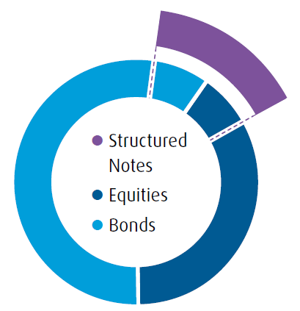
Portfolio Diversification with Structured Notes
Complement your traditional 60/40 portfolio with payout diversification and downside risk mitigation using structured notes.
Identify the portion of your portfolio that you are looking to diversify.
Compliment the core of your traditional portfolio with structured notes.
Improve the risk-to-return metrics of your tradition portfolio.

Slide 5
What are Autocallable Notes?
Autocallable notes are enhanced-yield strategies that provide investors the potential to receive an above market coupon along with downside contingent protection. Currently, Autocallable notes are the most frequently issued category of structured notes in Canada. Key benefits include:
Income generation
Contingent downside protection
Differentiated return profile from equities and bonds
Autocallable notes are medium-term market-linked investments with a call feature, contingent coupon payments and contingent principal protection.
Call Feature
Notes will be called (redeemed) at a pre-determined call observation date if the underlying reference asset’s level meets or exceeds the autocall level.
Contingent Coupon
A coupon is paid if, on a pre-determined coupon observation date, the underlying reference asset’s level meets or exceeds the coupon threshold.
Contingent Principal Protection
Autocallable notes offer contingent principal protection. If the note is not called prior to maturity, the initial principal is protected if the underlying reference asset’s level is at or above the protection level at maturity.

Slide 6
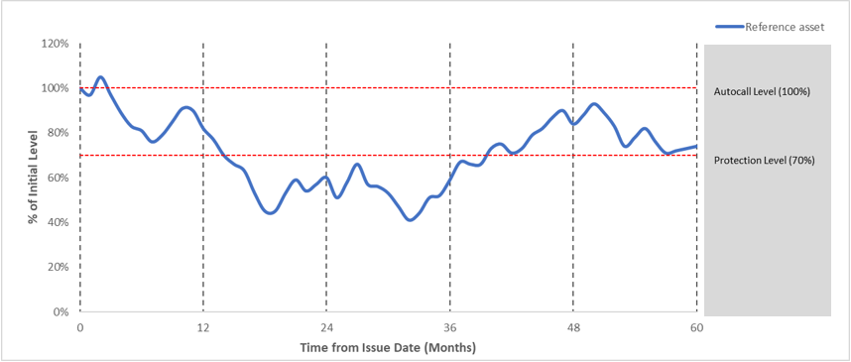
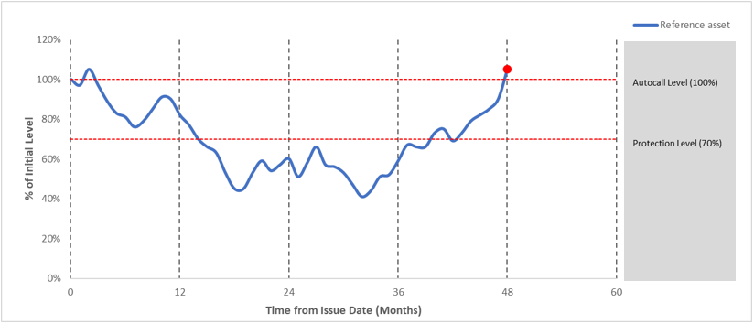
Types of Autocallable Notes
Autocallable Coupon Notes
Autocallable Memory Notes
Note, pay a return if called
Missed Coupons
Coupons are paid if, at a pre – determined coupon observation date, the reference asset level is at or above the coupon threshold (70% in example).
Notes are called (redeemed) if reference asset level is at or above the Autocall Level.

Slide 7
Challenges Of Building an Autocallable Note Portfolio
Challenges of building a structured note portfolio for clients:
Line item fatigue
Short offering periods
Requires extensive monitoring and portfolio management
Single notes are concentrated in one sector or industry
Issuers limited to Canadian Banks

Slide 8
What does the Fund Invest in?
The Fund intends to gain exposure to Autocallable Notes exposure via:
Total Return Swap (TRS) – a contractual agreement with a counterparty, where the receiver (the Fund) agrees to periodically pay a set rate to the counterparty (usually a large bank) in exchange for payments based on the returns of an underlying asset.
Replication of Autocallable Notes – invest into the individual components of Autocallable Notes to synthetically recreate their risk-reward profiles.
Direct investment in Autocallable Notes – directly purchase the notes from issuers (typically major Canadian or big International banks).

Slide 9
BMO Strategic Equity Yield Fund
The BMO Strategic Equity Yield Fund (the “Fund”) replicates the exposure of an actively managed portfolio of Autocallable notes, which are hybrid security that have characteristics of both fixed income instruments and equity securities. This has the benefit of:
Giving investors access to structured notes in an open-ended fund format
Providing an above-market distribution target yield of 8%
Offering downside protection against moderate market declines
Simplifying life cycle management of notes for advisors
* Target Distribution Yield was calculated by using the expected annualized distribution yield (which may be based on income, dividends, return of capital and option premiums as applicable) of the underlying portfolio and excluding any capital gains from portfolio turnover, less expenses. The distribution rate is based on the starting NAV of $10. Distribution yield is not an indicator of overall performance and will change based on market conditions, NAV fluctuations, and is not guaranteed.

Slide 10
How does Autocallable Note Replication Work?
Standard portfolio of two structured notes:
Autocallable Note #1
Autocallable Note #2
Replication of two structured notes in the fund:
Bond and/or Equity Forward Agreements
Bond and/or Equity Forward Agreements
Equity
Derivatives
Equity
Derivatives
Trading Fees
Bond and/or Equity Forward Agreements
Management
Fee
Equity
Derivatives
Bond and/or Equity Forward Agreements
Equity
Derivatives
Trading Fees
Replication provides the advantages of lower fees than a standard portfolio of structured notes

Slide 11
BMO Strategic Equity Yield Fund Offers The Following Key Benefits
Diversification
The payoff profile for autocallable notes is different from equity and fixed income products.
Time savings
Actively managing a large portfolio of notes is time consuming and cumbersome for the client, as notes get called frequently in a rising equity market
Target a Yield* of 8.0%
Target Yield of:
Exposure to a range of autocallable products across different geography and sectors
Experienced Management Team
Portfolio managers with extensive experience in Capital Markets and Wealth Management
Monthly Cash Flow
The BMO Strategic Equity Yield Fund aims to deliver stable monthly income to investors.
F-series: 8.0%
A-series: 7.0%
Monthly distribution of $1,667 on a $250k initial principal (assuming 8% target yield)
Currency hedging
Clients gain exposure to the underlying asset and returns are not affected by movements in currency pairs
Contingent principal protection
Autocallable notes provide partial downside protection. If the note is not called prior to maturity, the initial principal is protected if the underlying asset’s level is at or above the protection level at maturity
Lower Minimum Investments
Clients can have access to expensive assets that require higher capital investments within this fund, as there are low minimum requirements
Accessibility
Typically, structured notes have a limited selling window, typically two weeks. Within an open fund structure, clients can invest into the fund at any time
* Estimated Distribution Yield was calculated by using the expected annualized distribution yield (which may be based on income, dividends, return of capital and option premiums as applicable) of the underlying portfolio and excluding any capital gains from portfolio turnover, less expenses. The distribution rate is based on the starting NAV of $10. Distribution yield is not an indicator of overall performance and will change based on market conditions, NAV fluctuations, and is not guaranteed.
Notes:
This type of investment is suitable for clients who are seeking enhanced yields, downside protection, product/payoff diversification and currency hedging. This provides clients with lots of benefits and time savings, as the client would not have to go out and purchase a range of products and assets to achieve the same type of risk-to-return profile.

Slide 12
Key Benefits Of The Fund
Current Note Holders
Steadier cash flow than underlying notes
Low maintenance: eliminates need to manually roll into new positions when notes expire or get called
Access to multiple dealers
Simple redemption process
Institutional FX hedging
Professional management
Liquidity
Low purchase minimums
Non-Note Holders
Potential Higher yield than traditional investment products
Protection against moderate markets downturns
Diversification in potential payoffs vs. broad financial markets
Notes:
The portfolio is composed of vanilla bonds, OTC options, securitised options, overlays and bonds with embedded options

Slide 13
Investment Strategy
Top-down Fundamental Research
Bottom-up Analysis
Active Portfolio Management
Actively managed portfolio that utilized a combination of top-down and bottom-up approaches for securities screening and selection.
Top-down fundamental analysis used to identify favourable industry or sectors.
Bottom-up approach using financial statement analysis, relative valuation and/or company research.
The fund can take positions in derivatives to hedge the portfolio in market downturns.
The fund seeks to maximize risk-weighted returns that exceeds major equity indexes.

Slide 14
Portfolio Rebalancing
Tactical Rebalancing
Portion of the portfolio can be rebalanced to achieve higher yields.
Portfolio Drift Rebalancing
If the target weights for sector, industry or geography drift, portions of the portfolio could be bought/sold to achieve the target weight.
Sector, Industry or Region Underperformance Rebalancing
If the outlook for a sector, industry or region is expected to underperform, positions that are expected to underperform may be sold.

Slide 15
BMO Strategic Equity Yield Fund Details
Fund Parameter | Detail
Fund Name | BMO Strategic Equity Yield Fund
Fund Manager | BMO Investments Inc.
Strategy | Autocallable Fund
Investment Universe | The autocallable reference assets are major equity indices in Canada, US and Europe, as well as potentially equity securities from these indices. Autocallable notes can have one or more reference assets. The investment management team selects autocallable notes by seeking a balance between the choice of coupons, the capital protection barriers and the coupon barriers.
Series | F-series, Advisor-series, A-series
Fund Code | BMO95290, BMO99290, BMO70290
Launch Date | June 12, 2023
Currency | CAD
Liquidity | Daily
MER (Target) | F-series: 0.73%, Advisor-series, A-series: 1.86%
Trailer | 1.0%
* The listed target Management Expense Ratio (MER) are estimated. As the series of funds are less than one year old, actual MER costs will not be known until the fund financial statements for the current fiscal year are released.

Slide 16
BMO Strategic Equity Yield Fund
The following is representative of the reference assets of the Autocallable notes that the fund would be replicating.
The sample portfolio was constructed based on market research of Canadian investors’ preference and the fund managers’ understanding of the current market environment.
Geography (max weight %) | Reference Index | Sample Target Weight (%)
Canada (70%) | Canadian Banks | 20%-40%
 | Canadian Broad Equities | 5%-20%
 | Canadian Telecommunications | 0%-10%
 | Canadian Utilities | 0%-10%
 | Canadian Pipelines | 0%-5%
US (50%) | US Broad Equities | 5%-20%
 | US Big Banks | 0%-10%
 | US Life Insurance | 0%-10%
 | US Technology | 0%-10%
 | US Energy | 0%-10%
Other (20%) | Other | 0%-20%

Slide 17
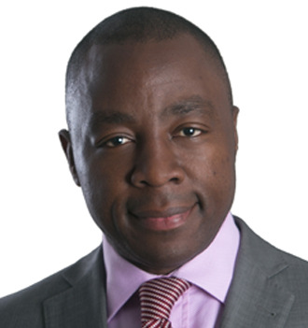
Portfolio Managers
Duy Le, CFA Portfolio Manager BMO Global Asset Management
Duy Le currently serves as a portfolio manager within the Synthetic Asset Management group at BMO Global Asset Management. Before joining BMO Global Asset Management, Duy worked in the Capital Markets industry at CIBC World Markets and BMO Capital Markets. At CIBC World Markets, Duy worked in the Structuring team where he gained experience in pricing and building innovative structured products for the bank's clients. After leaving CIBC World Markets, Duy joined BMO Capital Markets where he got the opportunity to co-lead the business development desk. Duy is a CFA Charterholder and holds an undergraduate degree in mechanical engineering from the University of Waterloo, a master's degree in computational combustion modeling in the University of Waterloo, a MBA from York University’s Schulich School of Business, a financial engineering graduate diploma from York University, and is currently enrolled in the master's of computer science degree at Georgia Institute of Technology.
Charles-Lucien Myssie, CIM Portfolio Manager BMO Global Asset Management
Charles has more than fifteen years of experience in the investment industry and serves as portfolio manager for derivative and equity-based portfolios. Prior to joining BMO, Charles served as Portfolio manager-Trader at the Canadian Pension Plan Investment Board where he managed equity derivatives value-added strategies and helped build the equity derivatives book. More recently, he played a key role as a derivatives strategist-sales with CIBC capital markets covering institutional clients such as pension plans, asset managers and real money accounts for the Quebec market. Prior to these experiences, Charles worked in various capacities with RBC-Corporate Treasury as a senior quant managing the bank’s balance sheet and on the cross-assets derivatives desk with Fortis bank France. Charles holds a master degree in Econometrics from the University Paris X, France.
Chris McHaney, CFA Portfolio Manager BMO Global Asset Management
Chris has more than 20 years of experience in the investment industry and currently serves as portfolio manager for equity-based and derivative-based mandates. This includes Canadian, US, international and emerging market equities, North American and European derivatives. He also co-manages various cross-asset portfolios, which include Canadian and US fixed income and global equities. In addition, Chris trades foreign exchange contracts and equity options for mandates across the firm. In his previous role, he was responsible for mutual fund manager selection and oversight, as well as management of the currency hedging program across the mutual fund platform. Chris holds an Honors Business Administration degree from York University’s Schulich School of Business and is a CFA charter holder.

Slide 18
Summary
BMO Strategic Equity Yield Fund
Long term return construction through a diversified stream of attractive coupons
Active Portfolio Management
Exposure to globally issued structured notes
Buffered downside protection
8.00% target annual yield*
* Estimated Distribution Yield was calculated by using the expected annualized distribution yield (which may be based on income, dividends, return of capital and option premiums as applicable) of the underlying portfolio and excluding any capital gains from portfolio turnover, less expenses. The distribution rate is based on the starting NAV of $10. Distribution yield is not an indicator of overall performance and will change based on market conditions, NAV fluctuations, and is not guaranteed.

Slide 19
Disclaimer
Distributions are not guaranteed and may fluctuate. Distribution rates may change without notice (up or down) depending on market conditions. The payment of distributions should not be confused with an investment fund’s performance, rate of return or yield. If distributions paid by an investment fund are greater than the performance of the fund, your original investment will shrink. Distributions paid as a result of capital gains realized by an investment fund, and income and dividends earned by an investment fund, are taxable in your hands in the year they are paid. Your adjusted cost base will be reduced by the amount of any returns of capital. If your adjusted cost base goes below zero, you will have to pay capital gains tax on the amount below zero. Please refer to the distribution policy for BMO Mutual Fund set out in the prospectus.
Distributions, if any, for all series of securities of a BMO Mutual Fund (other than ETF Series) are automatically reinvested in additional securities of the same series of the applicable BMO Mutual Fund, unless the securityholder elects in writing that that they prefer to receive cash distributions. For ETF Series securities of a BMO Mutual Fund, distributions, if any, may be paid in cash or reinvested automatically in additional ETF Series securities of the applicable BMO Mutual Fund and the ETF Series securities will be immediately consolidated such that the number of outstanding ETF Series securities following the distribution will equal the number of ETF Series securities outstanding prior to the distribution. If a securityholder is enrolled in a distribution reinvestment plan, distributions, if any, will be automatically reinvested in additional ETF Series securities of the applicable BMO Mutual Fund pursuant to the distribution reinvestment plan. For further information, see the distribution policy for the applicable BMO Mutual Fund in the simplified prospectus.
This communication is intended for informational purposes only and is not, and should not be construed as, investment and/or tax advice to any individual. Particular investments and/or trading strategies should be evaluated relative to each individual’s circumstances. Individuals should seek the advice of professionals, as appropriate, regarding any particular investment. Investors cannot invest directly in an index.
Any statement that necessarily depends on future events may be a forward-looking statement. Forward-looking statements are not guarantees of performance. They involve risks, uncertainties and assumptions. Although such statements are based on assumptions that are believed to be reasonable, there can be no assurance that actual results will not differ materially from expectations. Investors are cautioned not to rely unduly on any forward-looking statements. In connection with any forward-looking statements, investors should carefully consider the areas of risk described in the most recent simplified prospectus.
The viewpoints expressed by the Portfolio Manager represents their assessment of the markets at the time of publication. Those views are subject to change without notice at any time without any kind of notice. The information provided herein does not constitute a solicitation of an offer to buy, or an offer to sell securities nor should the information be relied upon as investment advice. Past performance is no guarantee of future results. This communication is intended for informational purposes only.
Commissions, trailing commissions (if applicable), management fees and expenses all may be associated with mutual fund investments. Please read the fund facts or prospectus of the relevant mutual fund before investing. Mutual funds are not guaranteed, their values change frequently and past performance may not be repeated. Distributions are not guaranteed and are subject to change and/or elimination.
For a summary of the risks of an investment in BMO Mutual Funds, please see the specific risks set out in the prospectus.
BMO Mutual Funds are managed by BMO Investments Inc., which is an investment fund manager and a separate legal entity from Bank of Montreal.
BMO Global Asset Management is a brand name under which BMO Asset Management Inc. and BMO Investments Inc. operate.
®/™Registered trademarks/trademark of Bank of Montreal, used under licence.

